Slide 1

Grappling With Growth
Tim Livingston
OPS 811

Slide 2
Company Overview
-Based in Stamford, CT
-Purchased by Vince McMahon in 1984; current owner and CEO
-Went public in October, 1999 with $172.5M valuation at $24.13 a share
-Sports entertainment conglomerate with 300+ live events each year globally
-Crossover success in movies, television, and music
Recent Financial Benchmarks
-$20.70 stock price with $1.62B valuation
-Cleared company record $729M in total revenue in 2016
-Q1 2017 reported 10% revenue growth year-to-year
-1.95M total subscribers to WWE Network as of March 31

Slide 3
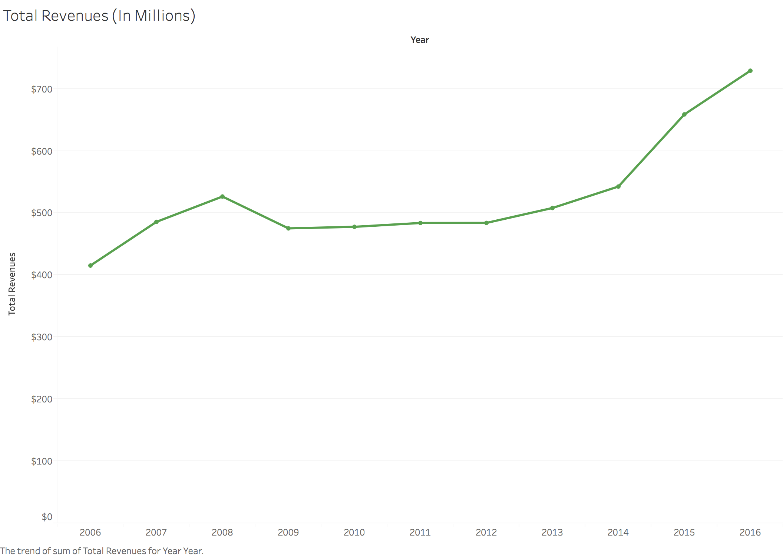
Notes:
After stagnant growth from 2007-2014, one full year of the WWE Network along with an increase in international attendance and the first year of a new television rights deal helped revenue grow in 2015 by over 20%. The trend is expected to go upward even further as Network subscribers increase and the later years of the rights deal kick in for a back loaded deal.

Slide 4
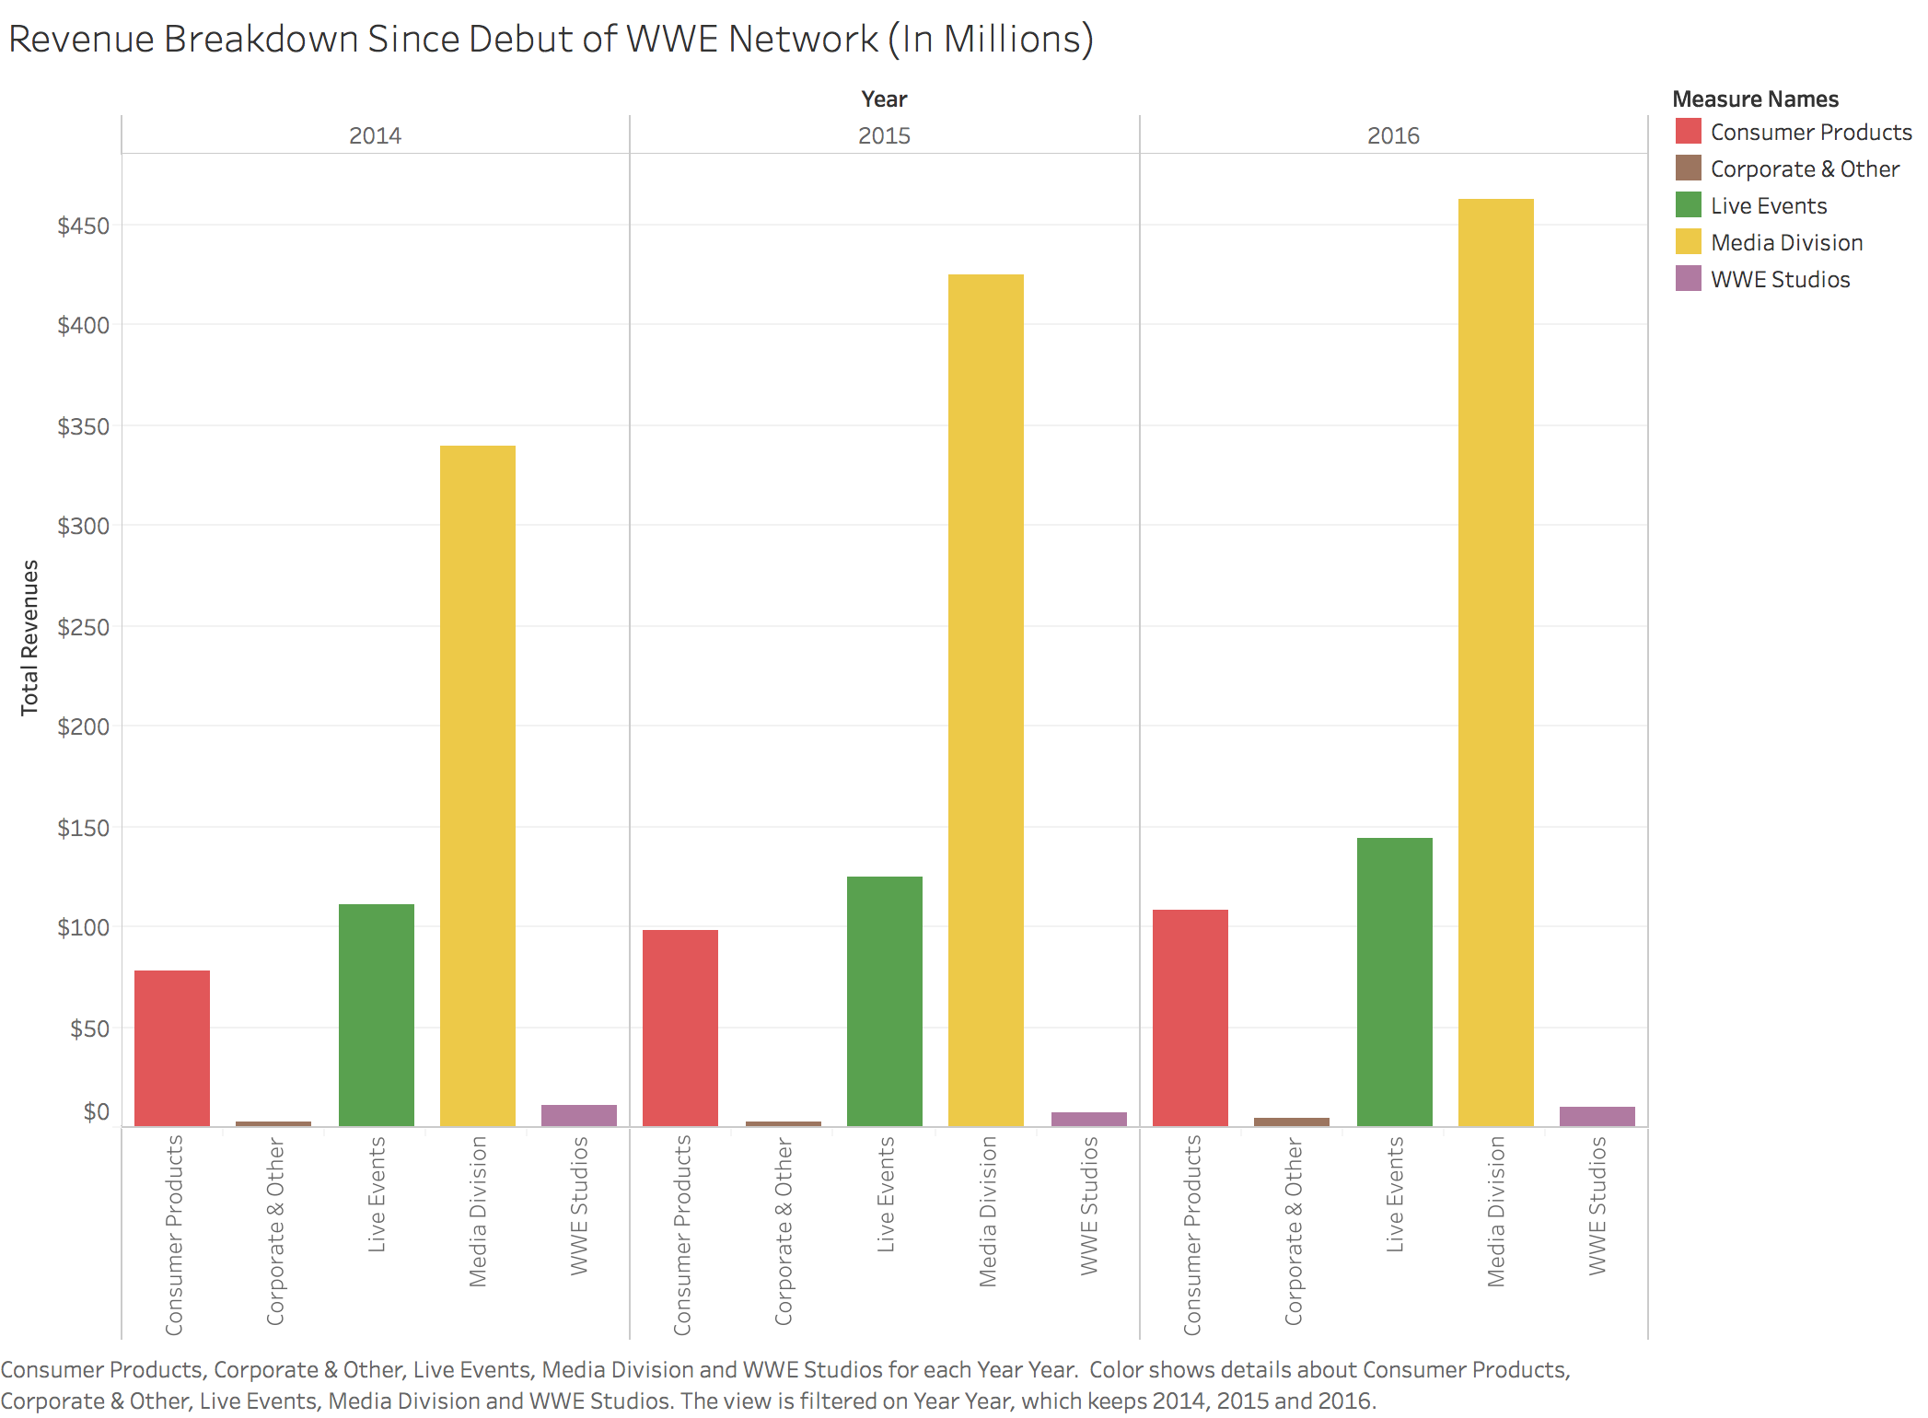
Notes:
The Media Division, which incorporates the WWE Network, Television Rights, and Pay-Per-View revenue streams, is the overwhelming revenue generator for the company, accounting for nearly 2/3 of the company’s total revenue in 2016. Live Events and Consumer Products (merchandise) combined do’t match up to even half the revenue brought in by the Media Division.

Slide 5
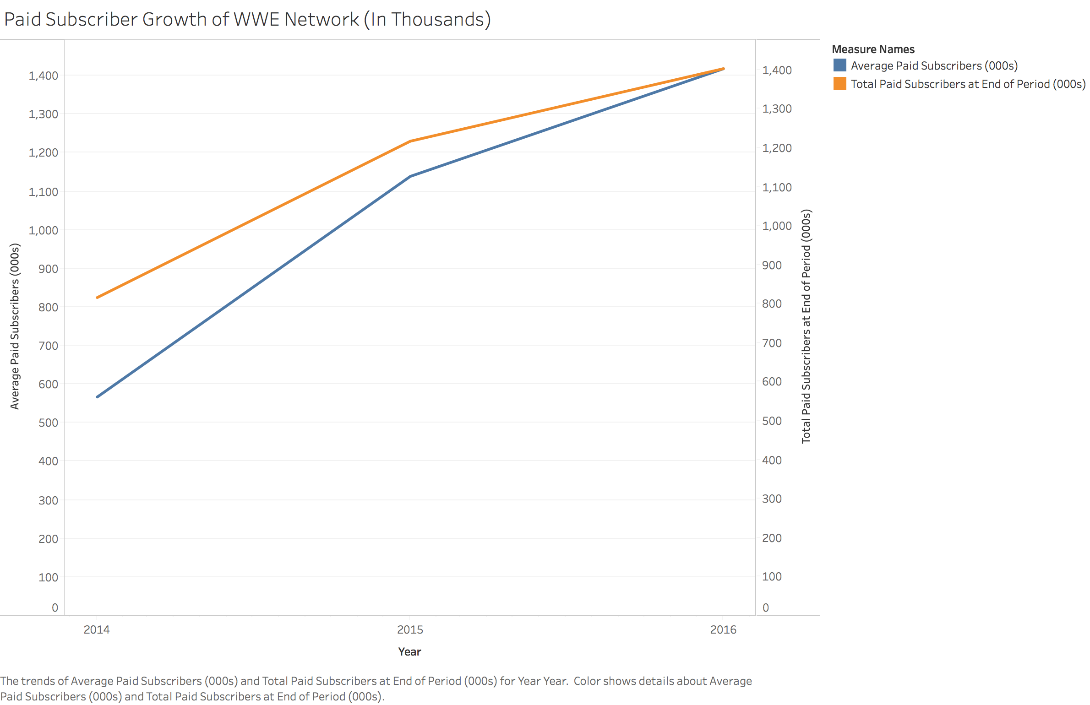
Notes:
With many consumers testing out the WWE Network early on in its release cycle, paid subscribers were behind total subscribers by about 250K early on. However, by the time the third year of the Network rolled around, the end of year count basically equaled the average paid subscribers, meaning there was more adoption and retention of subscribers by year’s end. Before this, fans would normally purchase only in time for the bigger events on the WWE calendar, but now it seems many are sticking around for much longer than just one big show.

Slide 6
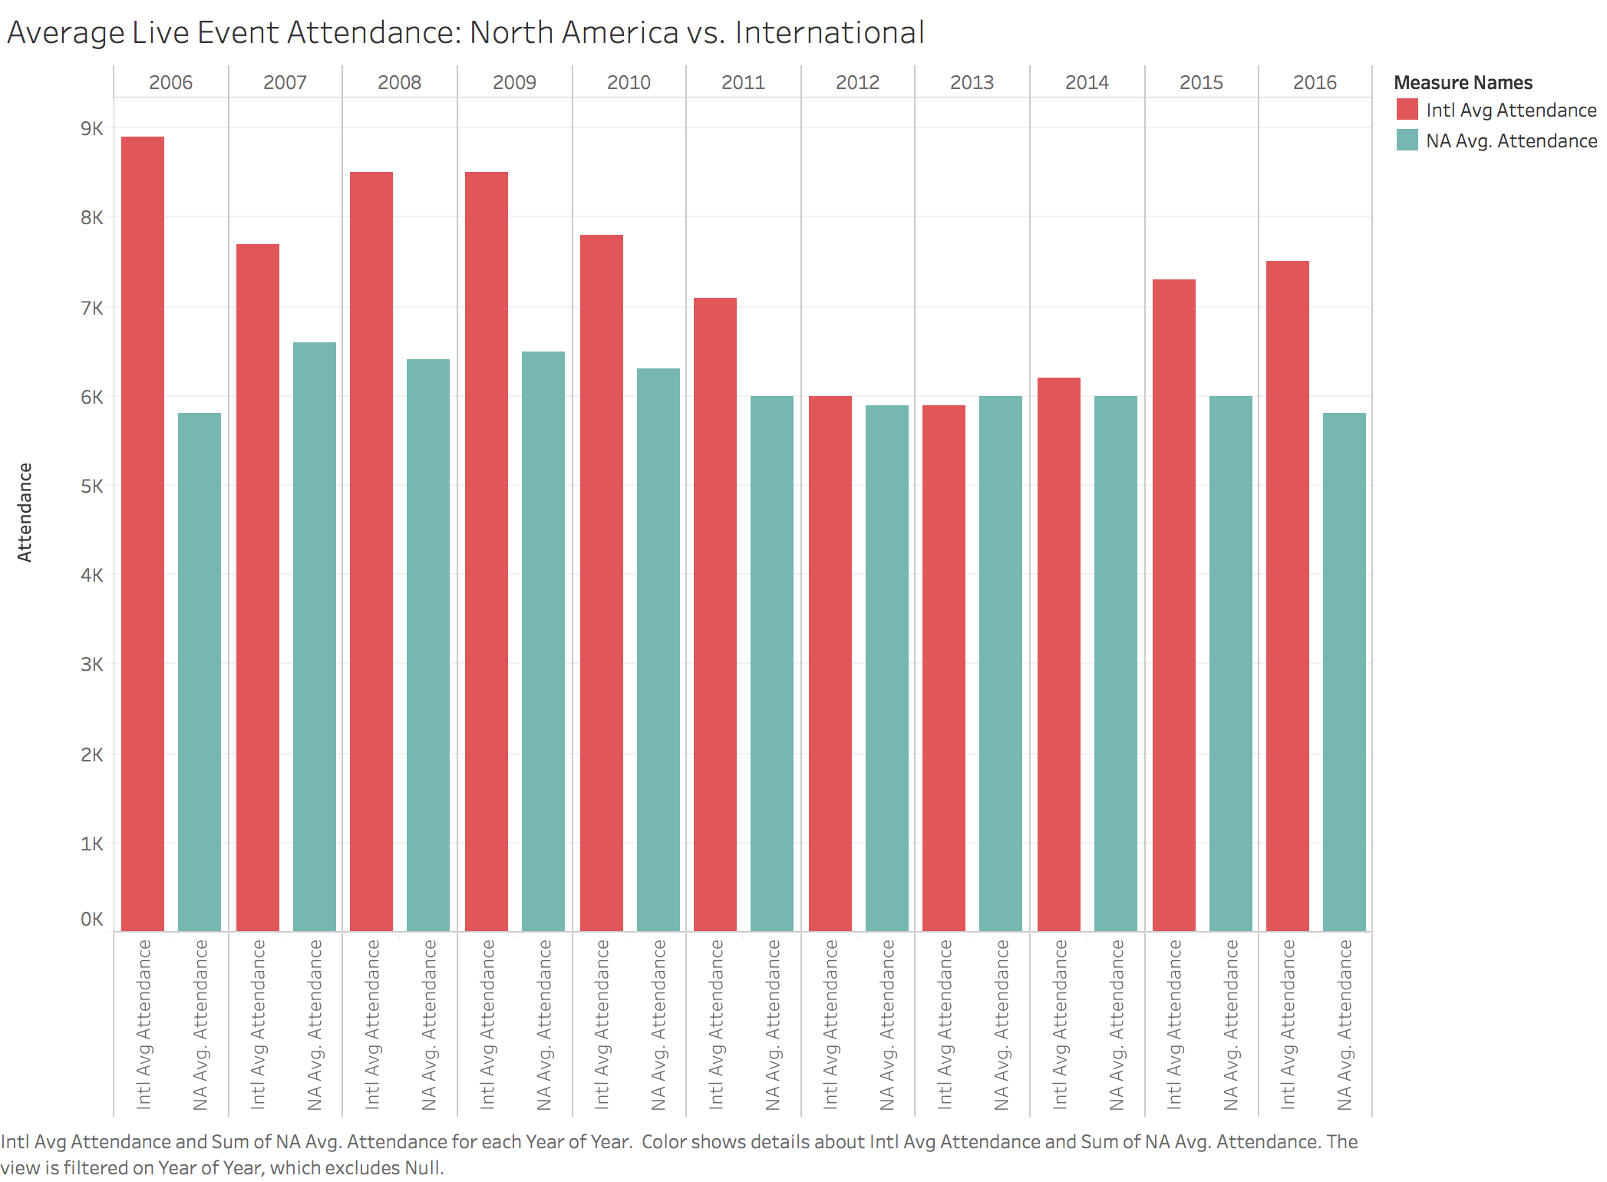
Notes:
If you’re wondering why WWE is skewing international going forward, look no further than this trend in live event attendance. While North American attendance has remained the same over the last decade-plus, the latest international uptick thanks to WWE Network exposure shows an opportunity to grow even further into countries like India and China. A renewed focus internationally could help keep revenue growth steady, and while reporting for Q2 is not expected until July, early expectations are optimistic for engagement overseas, especially in India thanks to the crowning of Jinder Mahal as champion two weeks ago.

